Slide 1
Group 5
Human Development in India

Slide 2
HDI
Economic Growth
&
Economic Development






Slide 3
Economic Growth
Economic growth is an increase in the capacity of an economy to produce goods and services, compared from one period of time to another.
A country's economic growth is usually indicated by an increase in that country's gross domestic product, or GDP.
Economic Growth caused by two main factors:
Increase in aggregate demand (AD=C+I+G+X-M)
Increase in aggregate supply (increase in capital, investment, higher labor productivity).
Policies to increase economic growth:
Supply Side Policies – government attempts to increase productivity and increase efficiency in the economy. The aim is to shift LRAS to the right.
Monetary Policy – Reducing interest rates to stimulate economic activity and increase AD.
Fiscal Policy – Higher government spending and / or cutting taxes to boost aggregate demand

Slide 4
Economic Growth
Benefits of Economic growth:
Higher incomes.
Increased tax revenue for government which can be spent on public services, e.g. education and health care.
Helps create employment.
Factors affecting economic growth:
Levels of infrastructure – e.g. transport and communication
Levels of corruption
Educational standards and labour productivity
Labour mobility
Flow of foreign aid and investment

Slide 5
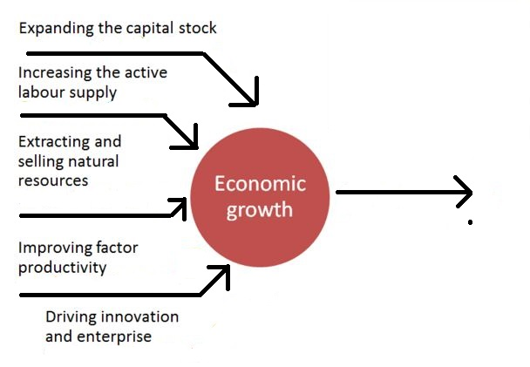
Key Drivers of Economic Growth

Slide 6
Economic Development
A country's economic development is usually indicated by an increase in citizens' quality of life. 'Quality of life' is often measured using the Human Development Index.
Development in humans means not only physical growth but also necessary changes that a person has to undergo to develop into mature individual.
This means that individual attitudes , habits, emotions, feelings and intelligence must undergo changes to fit into concept of matured individual.

Slide 7
Difference between Economic growth & development
Economic growth is one of the feature of economic development.
Economic growth is an automatic process. Unlike economic development, which is the outcome of planned and result oriented activities.
Economic growth enables an increase in the indicators like GDP, per capita income, etc. On the other hand, economic development enables improvement in the life expectancy rate, infant mortality rate, literacy rate and poverty rates.
Economic growth can be measured when there is a positive change in the national income, whereas economic development can be seen when there is an increase in real national income.
Economic growth is a short term process which takes into account yearly growth of the economy. But if we talk about economic development it is a long term process.

Slide 8
Difference between Economic growth & development
Economic Growth is applicable to developed economies to gauge to the quality of life, but as it is an essential condition for the development, it applies to developing countries also. In contrast to that, economic development is applicable to developing countries to measure progress.
Economic Growth results in quantitative changes, but economic development brings both quantitative and qualitative changes.
Economic growth can be measured in a particular period of time. As opposed to economic development is a continuous process, so it can be seen in the long run.

Slide 9
Economic growth without development
Economic growth may only benefit a small % of the population. For example, if a country produces more oil, it will see an increase in GDP. However, it is possible, that this oil is only owned by one firm, and therefore, the average worker doesn’t really benefit.
Corruption. A country may see higher GDP, but the benefits of growth may be siphoned into the bank accounts of politicians
Environmental problems. Producing toxic chemicals will lead to an increase in real GDP. However, without proper regulation it can also lead to environmental and health problems. This is an example of where growth leads to a decline in living standards for many.

Slide 10
Economic growth without development
Congestion. Economic growth can cause an increase in congestion. This means people will spend longer in traffic jams. GDP may increase but they have lower living standards because they spend more time in traffic jams.
Production not consumed. If a state owned industry increases output, this is reflected in an increase in GDP. However, if the output is not used by anyone then it causes no actual increase in living standards.
Military spending. A country may increase GDP through spending more on military goods. However, if this is at the expense of health care and education it can lead to lower living standards.

Slide 11
HDI
Human Development Index
Introduction






Slide 12
Human Development Index (History)
The origins of the HDI are found in the annual Development Reports of the United Nations Development Programme (UNDP).
These were devised and launched by Pakistani economist Mahbub ul Haq in 1990 and had the explicit purpose "to shift the focus of development economics from national income accounting to people-centered policies".
To produce the Human Development Reports, Mahbub ul Haq formed a group of development economists including Paul Streeten, Frances Stewart, Gustav Ranis, Keith Griffin, Sudhir Anand, and Meghnad Desai.
Working alongside Nobel laureate Amartya Sen, they worked on capabilities and functions that provided the underlying conceptual framework.
Haq was sure that a simple composite measure of human development was needed in order to convince the public, academics, and politicians that they can and should evaluate development not only by economic advances but also improvements in human well-being.

Slide 13
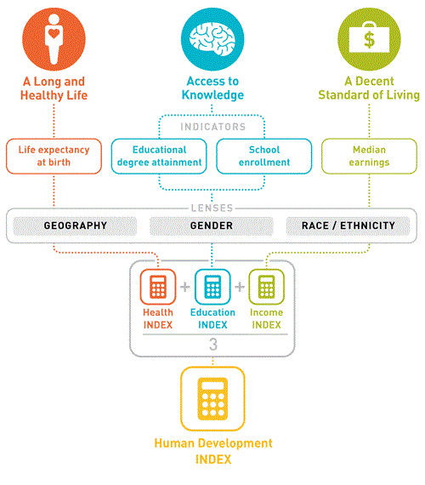
Dimensions of Human Development Index

Slide 14
Dimensions of Human Development Index
The Human Development Index (HDI) is a composite statistic of:
A long and healthy life, as measured by Life expectancy
Knowledge, as measured by the adult literacy rate.
A decent standard of living, as measured by Income per capita in purchasing power parity (PPP) terms in US dollars.
These indicators are used to rank countries into four tiers of human development.
A country scores higher HDI when the life expectancy at birth is longer, the education period is longer, and the income per capita is higher.

Slide 15
Categories of HDI
Each year, countries are ranked according to these measures.
Very High Human Development Index- 0.900 -1
High Human Development Index – HDI 0.699 - 0.899
Medium Human Development Index – HDI 0.522 to 0.698
Low Human Development Index – HDI below 0.521

Slide 16
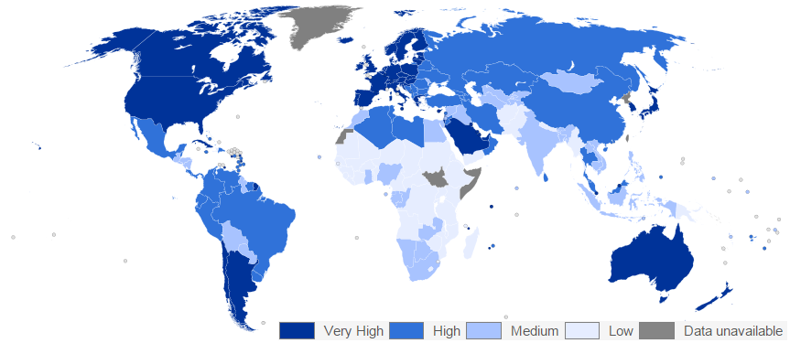
Human Development Index Globally

Slide 17




Calculations of Human Development Index
To calculate HDI we need the values of all the three indices.
Life Expectancy Index (LEI) =
Hence, LEI is 1 when Life expectancy at birth is 85 and 0 when Life expectancy at birth is 20.
Education Index (EI) =
Mean Years of Schooling Index (MYSI) =
Expected Years of Schooling Index (EYSI) =

Slide 18

Calculations of Human Development Index
Income Index (II) =
II is 1 when GNI per capita is $75,000 and 0 when GNI per capita is $100.
Finally, the HDI is the geometric mean of the previous three normalized indices:
GNIpc: Gross national income at purchasing power parity per capita

Slide 19
Success of HDI
Success of HDI Focus on the most basic dimension with universal value (the more comprehensive, the weaker) attracted attentions!
Though still contested by some of its validity, widely accepted – powerful advocate.
Generate healthy competition and create political will for change.
Identify priority indicators for further development and weakness in existing data (Philippines official statistics).
Spur the construction of other indices

Slide 20
HDI
Human Development in
India






Slide 21
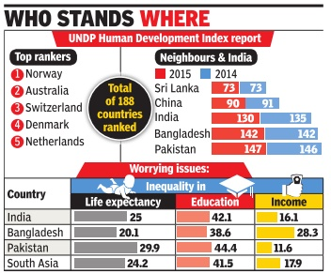
India’s HDI
stand

Slide 22
India’s HDI
over the years
India’s HDI
over the years

Slide 23
India’s Average HDI

Slide 24
HDI of India
India has been experiencing a consistently high growth rate during the post-liberalisation period following the implementation of economic reforms in the early 1990s.
It has achieved excellence in several key areas ranging from information technology and pharmaceuticals to automotive parts, and is now considered as one of the fastest growing economies of the world.
Despite these positive developments, India is still among the countries with some of the lowest indicators of human development.
Its levels of malnutrition, illiteracy and poverty are unacceptably high. The rise in income inequalities and regional the jobs created are not of high quality.

Slide 25
HDI of India
Although there has been an expansion in several social services like health, nutrition and education, the quality of most of these services remains poor in most of the rural areas.
And above all, an overwhelming majority of the population is deprived of basic social protection. Policy-makers are thus faced with a paradox—the persistence of deprivations and increasing insecurities among a large section of the population amidst growing affluence and prosperity for some.
The Eleventh Five-Year Plan has also reflected upon these concerns and has highlighted the need for balanced and ‘inclusive growth’.
India currently ranks 130 in global HDI according to international standards of living.

Slide 26
HDI
Limitations of
HDI






Slide 27
Limitations of HDI
Not a comprehensive measure of human development. It only focuses on three dimensions of capabilities.
The HDI is not designed to assess progress in human development over a short-term period because two of its component indicators—adult literacy and life expectancy at birth—are not responsive to short-term policy changes.
Like any average country measure, the HDI does not account for variations in human development within the country.
Countries with the same HDI may be very different in how human development is distributed, either from region to region, or from social group to social group.

Slide 28
Limitations of HDI
Wide divergence within countries.
Economic welfare depends upon several other factors, such as-threat of war, level of pollution, access to clean drinking water.
When knowledge is measured it only takes into account what children learn at school not in family. And so maybe knowledge statistics may be distorted if the family play more of a role in education in the home.
Life expectancy value for a country is the given is an average of the total population. There are many communities in the country that will not all have access to good healthcare services and so there will be variations of life expectancy values

Slide 29
Limitations of HDI
HDI fail to take account of qualitative factors, such as cultural identity and political freedoms.
GNI per capita-and consequently the HDI figure-takes no account of income distribution. If income is unevenly distributed, then GNI per capita will be an inaccurate measure of the monetary well-being of people.
Purchasing power parity Values used to adjust GNI data change quickly and can be inaccurate or misleading.
The HDI notably fails to take account of qualitative factors ,such as cultural identity and political freedom (human security, gender opportunities and human rights for example)

Slide 30
HDI
Gender Development Index






Slide 31
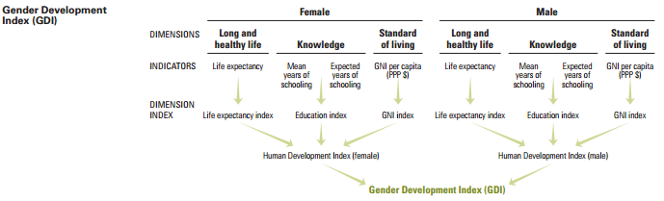
Gender Development Index

Slide 32
Gender Development Index
The new GDI measures gender gaps in human development achievements by accounting for disparities between women and men in three basic dimensions of human development - health, knowledge and living standards using the same component indicators as in the HDI.
The GDI is the ratio of the HDIs calculated separately for females and males using the same methodology as in the HDI.
It is a direct measure of gender gap showing the female HDI as a percentage of the male HDI.

Slide 33
GDI in India
Gender Development Index |  | Human Development Index (HDI) |  | Life expectancy at birth |  | Expected years of schooling |  | Mean years of schooling |  | Estimated gross national income per capita
Value | GDI group | Value |  | (years) |  | (years) |  | (years) |  | (2011 PPP $)
 |  | F | M | F | M | F | M | F | M | F | M
0.795 | 5 | 0.525 | 0.66 | 69.5 | 66.6 | 11.3 | 11.8 | 3.6 | 7.2 | 2,116 | 8,656

Slide 34
GDI in India
Countries are divided into 5 groups from high equality to very low equality between females and males.
We can clearly see that GDI is a real issue in India as our country was listed in Group 5(very low equality) as per GDI standards.
Female mean years of schooling is half as that of a male and regardless of genders, it fails to meet the expected years of schooling by at least 4.4 years which can be called as a poor standard of education.

Slide 35
HDI
Human Development in India
Issues & Solutions






Slide 36
Human Development in India Issues
Around 595 million people, which is nearly half the population of India, defecate in the open.
India accounts for 90 per cent of the people in South Asia and 59 per cent of the 1.1 billion people in the world who practice open defecation.
Girls and women have made major strides since 1990, but they have not yet gained gender equity. The disadvantages facing women and girls are a major source of inequality.
All too often, women and girls are discriminated against in health, education, political representation, labour market, etc — with negative repercussions for development of their capabilities and their freedom of choice.

Slide 37
Human Development in India Issues
About 22 million girls do not have access to a separate toilet facility in school.
Every year, diarrhoea kills 188,000 children under five in India.
About 43 per cent of children in India suffer from some degree of malnutrition.

Slide 38
Human Development in India Improvement
The five major themes which have the potential to improve the human development in India over the coming years are:
Education
Health and Nutrition
Employment and Skills
Social Protection
Improving the effectiveness of social programmes for attaining better human development outcomes

Slide 39
Education
The education policy should shift its focus from enrolment to improvement in the functioning of schools as well as towards raising the quality of education outcomes.
A more focused approach should be undertaken to provide the disabled groups access to both lower and upper primary classes, for removing social barriers to education.
Long-term goals are required to bridge the gender gap, which constitutes a key hurdle in achieving literacy in the country, along with measures to ensure universalization of elementary education among girls.

Slide 40
Education
The education policy should shift its focus from enrolment to improvement in the functioning of schools as well as towards raising the quality of education outcomes.
A more focused approach should be undertaken to provide the disabled groups access to both lower and upper primary classes, for removing social barriers to education.
Long-term goals are required to bridge the gender gap, which constitutes a key hurdle in achieving literacy in the country, along with measures to ensure universalization of elementary education among girls.

Slide 41
Education
A well-designed programme of recruitment of teachers needs to be put into place to ensure a high level of teaching quality and clear backlogs of vacancies at all levels
The issue of child labour, which is estimated at a whopping figure of 12 million, should be tackled at the earliest, as without it, there can be no improvement in child participations in school.

Slide 42
Health
The focus should be on certain wider sub-domains of healthcare like food and livelihood security, drinking water, women’s literacy, and above all: better nutrition and sanitation.
The public health policy should focus on the prevention of diseases by providing clean water and sanitation rather than fighting diseases by administering antibiotics.
Public expenditure on health in the country constitutes only around 1 % of the GDP. It should be raised to about 2 % during the next five years. There is also a dire shortage of healthcare staff. In order to meet these challenges, the government could partner with various stakeholders.

Slide 43
Nutrition
In order to reduce malnutrition, policies for increasing food productivity as well as for enhancing land use and desirable cropping patterns should be promoted.
Women’s empowerment can contribute greatly towards reducing malnutrition. This can be achieved by ensuring higher levels of schooling for girls, and higher age at marriage as well as higher maternal age at the birth of the first child.
Especially at the family and local community levels, informing the community about health and nutrition objectives; and generating enthusiasm and awareness to energise them into action is also an another way to of achieving the nutrition objectives of the country.

Slide 44
Employment and skills
The unorganised sector should be strengthened and sustained with investment to ensure its growth. Due to inter-dependence between the organised and unorganised sectors, labour productivity in the unorganised sector is crucial for improving employment conditions in the organised sector.
This is also important from the perspective of human development as an estimated 90 % of the nation’s workforce is currently engaged in the unorganised sector or the informal economy.
As there is an enormous shortage of skilled labours, industry-specific and technology specific skills also need to be simultaneously promoted.
Wages should be monitored to examine the labour market and wage fluctuations.

Slide 45
Social Protection
The disparities between rural-urban areas must be reduced for ensuring higher economic growth.
This also addresses the social protection needs of special groups such as migrant workers, the elderly, persons with disabilities, and tribals.
As social security is mostly available only for organised sector, the rest 93 % of workforce which are not engaged in formal work, must be ensured social security needs to the place of work.

Slide 46
Strengthening the Social Programmes
for Improved Human Development Outcomes
Provision of services enhancing human development outcomes, such as health and education, cannot be left solely to the market because of the existing critical market failures as well as due to both inelastic demand and substantial information asymmetries.
Public–private partnerships may be an effective means of service delivery in these areas.
The spreading of awareness of the benefits and government programs combined with the efforts of educated people helping others will finally bring India to a higher standard in Human development.

Slide 47
Group 5
Thank You

